Slide 1
MUSIC PLAYLIST APPLICATION
PRESENTED BY
1. 24KB1A3032 – G.BHAVYASRI
2. 24KB1A3069 - N.HARIKA
3. 24KB1A3085 - P.ASMITHA
4. 24KB1A30D1 - Y.YAMINI

Slide 2
OBJECTIVE
This presentation outlines a music playlist application implemented in c
Using double linked lists features included in this are adding songs,playing the next and previous tracks, showing the playlist and exsiting the application

Slide 3
FEATURES
Add and Remove Songs Allow users to add songs to the playlist or remove them when they want. ➤ This uses a linked list or array to store songs.
Play Next and Previous Songs Let users move forward and backward in the playlist. ➤ A doubly linked list helps with easy navigation.
Shuffle Songs Mix up the order of songs randomly. ➤ An array with a shuffle algorithm (like Fisher-Yates) works well.
Repeat Songs Repeat the same song or loop the entire playlist. ➤ A circular linked list can help loop through songs continuously.
5. Search Songs Let users find songs by name or artist. ➤ Use a hash map or a simple search through the list.

Slide 4
Library Files Used:
stdio.h – for input/output
stdlib.h – for general utilities
string.h – for handling strings
ctype.h – for character functions

Slide 5
STRUCTURE TO REPRESENT A SONG :
Struct song{
char title[100];
struct song*prev:
struct song*next;
};
Gobal pointers to manage playlist
Struct song *head=NULL;
struct song *tail=NULL;
struct song *current=NULL;

Slide 6
Source code
https://www.programiz.com/online-compiler/6oVgtxY2mE00R

Slide 7
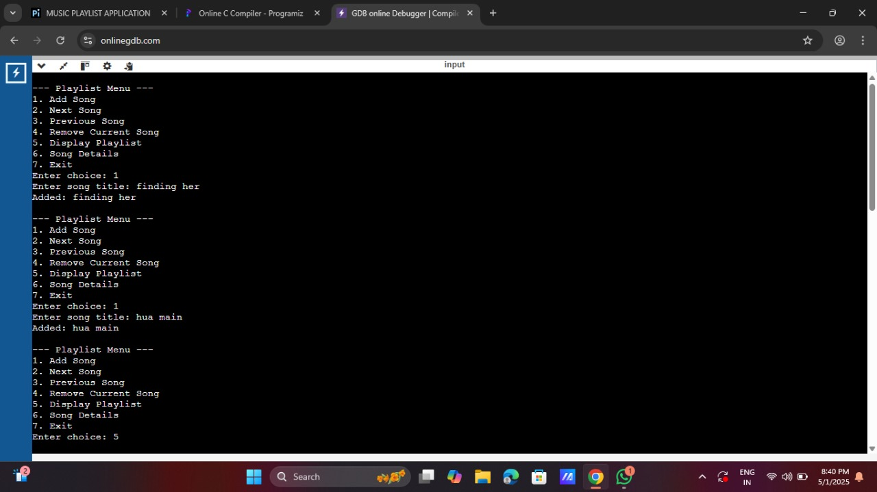
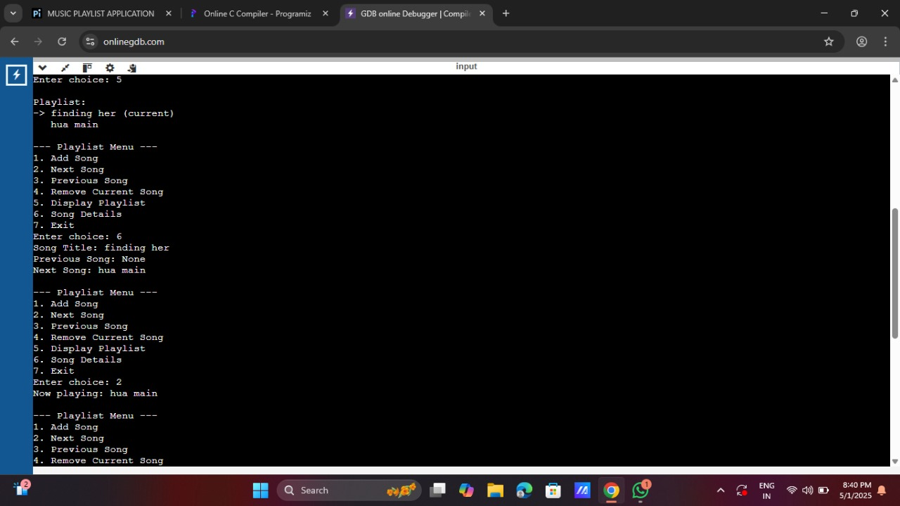
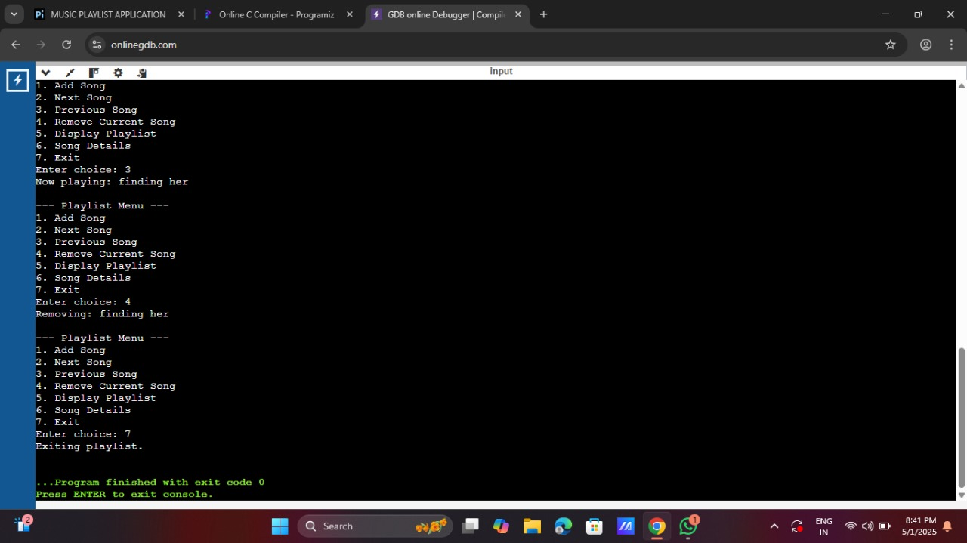
OUTPUT

Slide 8
CONCLUSION
Using a linked list to build a music playlist in C makes it easy to add, remove, and navigate songs efficiently. It’s a great way to learn pointers and dynamic memory management."

Slide 9
FUTURE ENHANCEMENTS
➕ Add backward navigation using a doubly linked list
💾 Enable saving/loading playlists with file handling
🔁 Include shuffle and repeat features
🎛️ Create a simple user-friendly interface

Slide 10
THANK YOU

